Slide 1
Algorithms and Data Structures
Lecture XI
Simonas Šaltenis
Nykredit Center for Database Research
Aalborg University
simas@cs.auc.dk

Slide 2
This Lecture
Longest Common Subsequence algorithm
Graphs – principles
Graph representations
  adjacency list
  adjacency matrix
Traversing graphs
  Breadth-First Search
  Depth-First Search

Slide 3
Longest Common Subsequence
Two text strings are given: X and Y
There is a need to quantify how similar they are:
  Comparing DNA sequences in studies of evolution of different species
  Spell checkers
One of the measures of similarity is the length of a Longest Common Subsequence (LCS)

Slide 4
LCS: Definition
Z is a subsequence of X, if it is possible to generate Z by skipping some (possibly none) characters from X
For example: X =“ACGGTTA”, Y=“CGTAT”, LCS(X,Y) = “CGTA” or “CGTT”
To solve LCS problem we have to find “skips” that generate LCS(X,Y) from X, and “skips” that generate LCS(X,Y) from Y

Slide 5
LCS: Optimal Substructure
We make Z to be empty and proceed from the ends of X_{m}=“x₁ x₂ …x_{m}” and Y_{n}=“y₁ y₂ …y_{n}”
  If x_{m}=y_{n}, append this symbol to the beginning of Z, and find optimally LCS(X_{m-1}, Y_{n-1})
  If x_{m}≠y_{n},
    Skip either a letter from X
    or a letter from Y
    Decide which decision to do by comparing LCS(X_{m}, Y_{n-1}) and LCS(X_{m-1}, Y_{n})
  “Cut-and-paste” argument

Slide 6
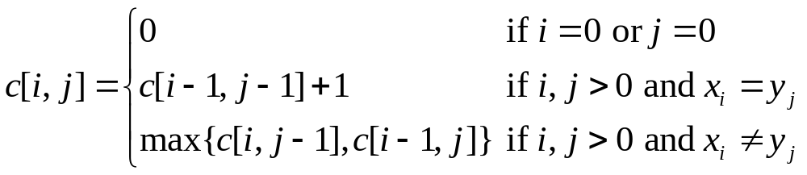
LCS: Reccurence
The algorithm could be easily extended by allowing more “editing” operations in addition to copying and skipping (e.g., changing a letter)
Let c[i,j] = LCS(X_{i}, Y_{j})
Observe: conditions in the problem restrict sub-problems (What is the total number of sub-problems?)

Slide 7
LCS: Compute the Optimum
LCS-Length(X, Y, m, n)
1 for i←1 to m do
2 c[i,0] ← 0
3 for j←0 to n do
4 c[0,j] ← 0
5 for i←1 to m do
6 for j←1 to n do
7 if x_{i} = y_{j} then
c[i,j] ← c[i-1,j-1]+1
9 b[i,j] ← ”copy”
10 else if c[i-1,j] ≥ c[i,j-1] then
c[i,j] ← c[i-1,j]
b[i,j] ← ”skipx”
13 else
c[i,j] ← c[i,j-1]
b[i,j] ← ”skipy”
16 return c, b

Slide 8
LCS: Example
Lets run: X =“CGTA”, Y=“ACTT”
How much can we reduce our space requirements, if we do not need to reconstruct LCS?

Slide 9
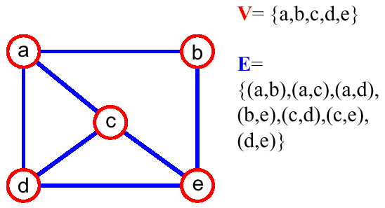
Graphs – Definition
A graph G = (V,E) is composed of:
  V: set of vertices
  E⊂ V× V: set of edges connecting the vertices
An edge e = (u,v) is a pair of vertices
(u,v) is ordered, if G is a directed graph

Slide 10
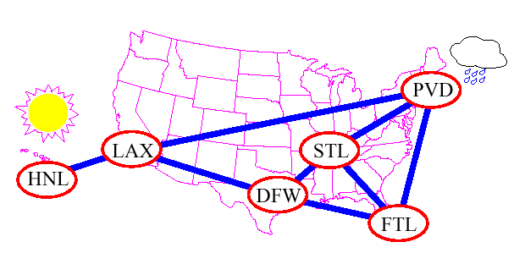
Applications
Electronic circuits, pipeline networks
Transportation and communication networks
Modeling any sort of relationtionships (between components, people, processes, concepts)

Slide 11
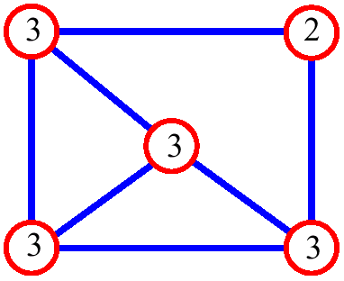
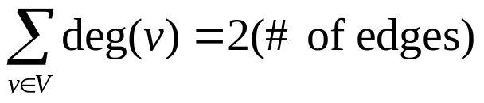
Graph Terminology
adjacent vertices: connected by an edge
degree (of a vertex): # of adjacent vertices
path: sequence of vertices v₁ ,v₂ ,. . .v_{k} such that consecutive vertices v_{i} and v_{i+1} are adjacent
Since adjacent vertices each count the adjoining edge, it will be counted twice

Slide 12
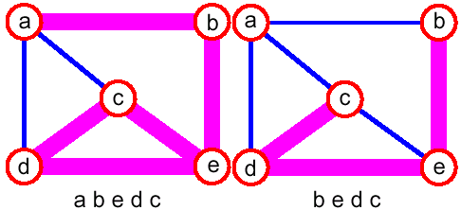
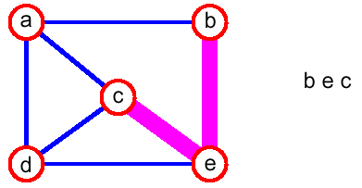
Graph Terminology (2)
simple path: no repeated vertices

Slide 13
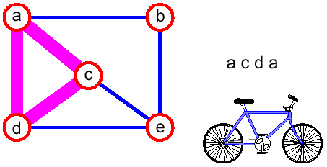
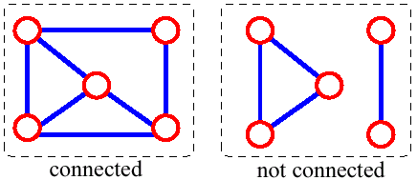
Graph Terminology (3)
cycle: simple path, except that the last vertex is the same as the first vertex
connected graph: any two vertices are connected by some path

Slide 14
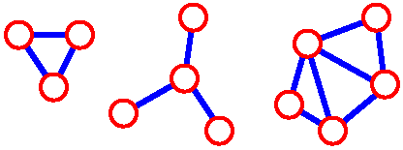
Graph Terminology (4)
subgraph: subset of vertices and edges forming a graph
connected component: maximal connected subgraph. E.g., the graph below has 3 connected components

Slide 15
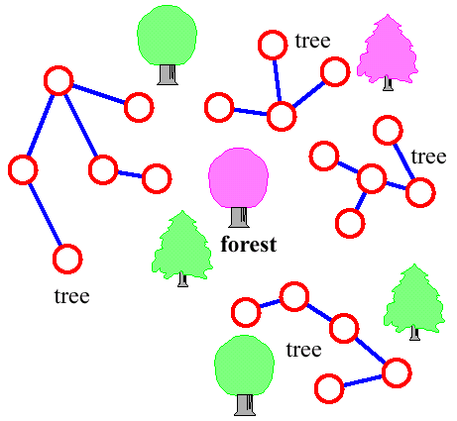
Graph Terminology (5)
(free) tree - connected graph without cycles
forest - collection of trees

Slide 16
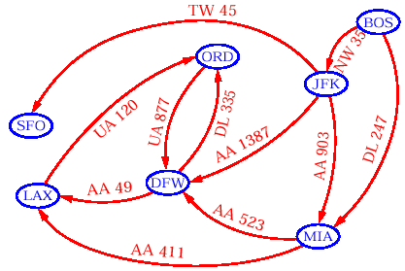
Data Structures for Graphs
How can we represent a graph?
  To start with, we can store the vertices and the edges in two containers, and we store with each edge object references to its start and end vertices

Slide 17
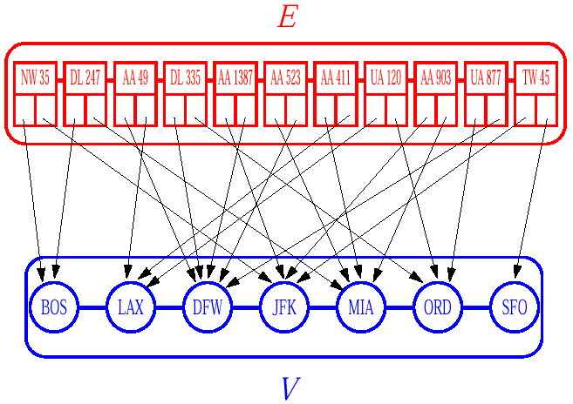
Edge List
The edge list
  Easy to implement
  Finding the edges incident on a given vertex is inefficient since it requires examining the entire edge sequence

Slide 18
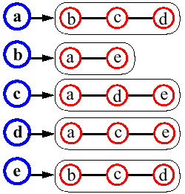
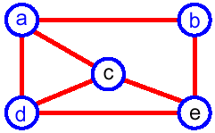
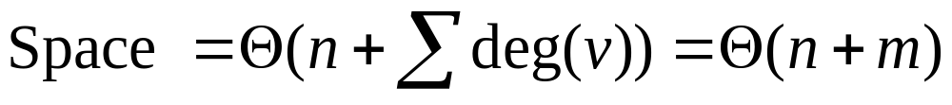
Adjacency List
The Adjacency list of a vertex v: a sequence of vertices adjacent to v
Represent the graph by the adjacency lists of all its vertices

Slide 19
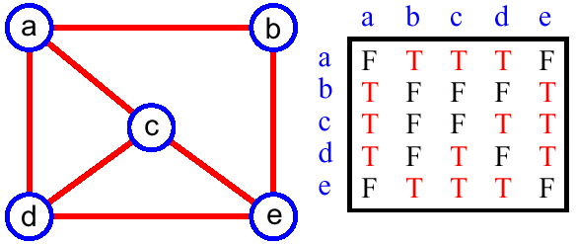
Adjacency Matrix
Matrix M with entries for all pairs of vertices
M[i,j] = true – there is an edge (i,j) in the graph
M[i,j] = false – there is no edge (i,j) in the graph
Space = O(n²)

Slide 20
Graph Searching Algorithms
Systematic search of every edge and vertex of the graph
Graph G = (V,E) is either directed or undirected
Today's algorithms assume an adjacency list representation
Applications
  Compilers
  Graphics
  Maze-solving
  Mapping
  Networks: routing, searching, clustering, etc.

Slide 21
Breadth First Search
A Breadth-First Search (BFS) traverses a connected component of a graph, and in doing so defines a spanning tree with several useful properties
BFS in an undirected graph G is like wandering in a labyrinth with a string.
The starting vertex s, it is assigned a distance 0.
In the first round, the string is unrolled the length of one edge, and all of the edges that are only one edge away from the anchor are visited (discovered), and assigned distances of 1

Slide 22
Breadth-First Search (2)
In the second round, all the new edges that can be reached by unrolling the string 2 edges are visited and assigned a distance of 2
This continues until every vertex has been assigned a level
The label of any vertex v corresponds to the length of the shortest path (in terms of edges) from s to v

Slide 23
BFS Example
r
s
t
u
r
s
t
u
∞
0
∞
∞
1
0
∞
∞
Q
s
Q
w
r
∞
∞
∞
∞
0
∞
1
∞
∞
1
1
v
w
x
y
v
w
x
y
r
s
t
u
r
s
t
u
1
0
2
∞
1
0
2
∞
Q
r
t
x
Q
t
x
v
∞
1
2
∞
1
2
2
2
1
2
∞
2
2
2
v
w
x
y
v
w
x
y

Slide 24
BFS Example
r
s
t
u
r
s
t
u
1
0
2
3
1
0
2
3
Q
x
v
u
Q
v
u
y
2
1
2
∞
2
2
3
2
1
2
3
2
3
3
v
w
x
y
v
w
x
y
r
s
t
u
r
s
t
u
1
0
2
3
1
0
2
3
Q
u
y
Q
y
2
1
2
3
3
3
2
1
2
3
3
v
w
x
y
v
w
x
y

Slide 25
BFS Example: Result
r
s
t
u
1
0
2
3
Q
-
2
1
2
3
v
w
x
y

Slide 26
BFS Algorithm
BFS(G,s)
01 for each vertex u ∈ V[G]-{s}
02 color[u] ← white
03 d[u] ← ∞
04 π[u] ← NIL
05 color[s] ← gray
06 d[s] ← 0
07 π[u] ← NIL
08 Q ← {s}
09 while Q ≠ ∅ do
10 u ← head[Q]
11 for each v ∈ Adj[u] do
12 if color[v] = white then
13 color[v] ← gray
14 d[v] ← d[u] + 1
15 π[v] ← u
16 Enqueue(Q,v)
17 Dequeue(Q)
18 color[u] ← black
Init all vertices
Init BFS with s
Handle all u’s children before handling any children of children

Slide 27
BFS Running Time
Given a graph G = (V,E)
  Vertices are enqueued if there color is white
  Assuming that en- and dequeuing takes O(1) time the total cost of this operation is O(V)
  Adjacency list of a vertex is scanned when the vertex is dequeued (and only then…)
  The sum of the lengths of all lists is Θ(E). Consequently, O(E) time is spent on scanning them
  Initializing the algorithm takes O(V)
Total running time O(V+E) (linear in the size of the adjacency list representation of G)

Slide 28
BFS Properties
Given a graph G = (V,E), BFS discovers all vertices reachable from a source vertex s
It computes the shortest distance to all reachable vertices
It computes a breadth-first tree that contains all such reachable vertices
For any vertex v reachable from s, the path in the breadth first tree from s to v, corresponds to a shortest path in G

Slide 29
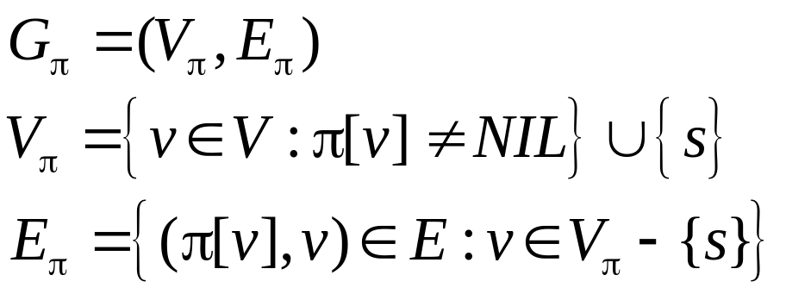
Breadth First Tree
Predecessor subgraph of G
G_{π} is a breadth-first tree
  V_{π} consists of the vertices reachable from s, and
  for all v ∈ V_{π}, there is a unique simple path from s to v in G_{π} that is also a shortest path from s to v in G
The edges in G_{π} are called tree edges

Slide 30
Depth-First Search
A depth-first search (DFS) in an undirected graph G is like wandering in a labyrinth with a string and a can of paint
  We start at vertex s, tying the end of our string to the point and painting s “visited (discovered)”. Next we label s as our current vertex called u
  Now, we travel along an arbitrary edge (u,v).
  If edge (u,v) leads us to an already visited vertex v we return to u
  If vertex v is unvisited, we unroll our string, move to v, paint v “visited”, set v as our current vertex, and repeat the previous steps

Slide 31
Depth-First Search (2)
Eventually, we will get to a point where all incident edges on u lead to visited vertices
We then backtrack by unrolling our string to a previously visited vertex v. Then v becomes our current vertex and we repeat the previous steps
Then, if all incident edges on v lead to visited vertices, we backtrack as we did before. We continue to backtrack along the path we have traveled, finding and exploring unexplored edges, and repeating the procedure

Slide 32
DFS Algorithm
Initialize – color all vertices white
Visit each and every white vertex using DFS-Visit
Each call to DFS-Visit(u) roots a new tree of the depth-first forest at vertex u
A vertex is white if it is undiscovered
A vertex is gray if it has been discovered but not all of its edges have been discovered
A vertex is black after all of its adjacent vertices have been discovered (the adj. list was examined completely)

Slide 33
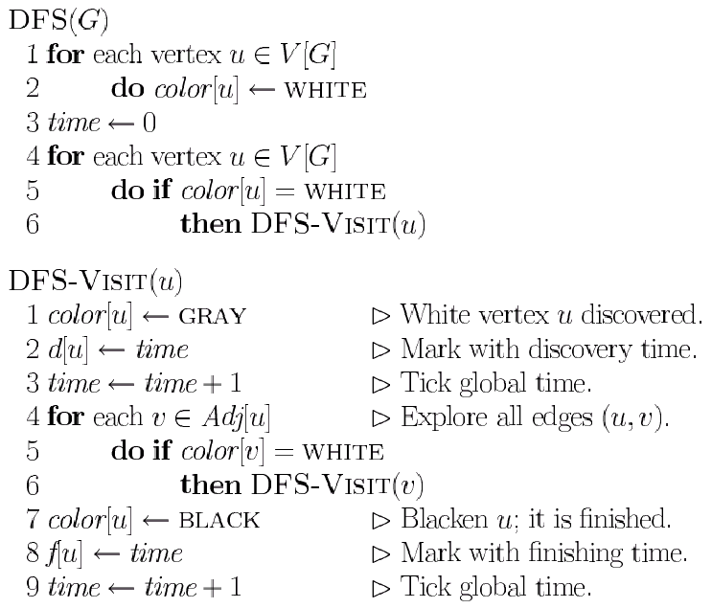
DFS Algorithm (2)
Init all vertices
Visit all children recursively

Slide 34
DFS Example
u
v
w
u
v
w
u
v
w
1/
1/
2/
1/
2/
3/
x
y
z
x
y
z
x
y
z
u
v
w
u
v
w
u
v
w
1/
2/
1/
2/
1/
2/
B
B
4/
3/
4/
3/
4/5
3/
x
y
z
x
y
z
x
y
z

Slide 35
DFS Example (2)
u
v
w
u
v
w
u
v
w
1/
2/
1/
2/7
1/
2/7
B
B
F
B
4/5
3/6
4/5
3/6
4/5
3/6
x
y
z
x
y
z
x
y
z
u
v
w
u
v
w
u
v
w
1/8
2/7
1/8
2/7
9/
1/8
2/7
9/
B
B
B
C
F
F
F
4/5
3/6
4/5
3/6
4/5
3/6
x
y
z
x
y
z
x
y
z

Slide 36
DFS Example (3)
u
v
w
u
v
w
u
v
w
1/8
2/7
9/
1/8
2/7
9/
1/8
2/7
9/
B
C
B
C
B
C
F
F
F
4/5
3/6
10/
4/5
3/6
10/
B
4/5
3/6
10/11
B
x
y
z
x
y
z
x
y
z
u
v
w
1/8
2/7
9/12
B
C
F
4/5
3/6
10/11
B
x
y
z

Slide 37
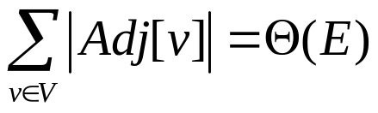
DFS Algorithm (3)
When DFS returns, every vertex u is assigned
  a discovery time d[u], and a finishing time f[u]
Running time
  the loops in DFS take time Θ(V) each, excluding the time to execute DFS-Visit
  DFS-Visit is called once for every vertex
    its only invoked on white vertices, and
    paints the vertex gray immediately
  for each DFS-visit a loop interates over all Adj[v]
  the total cost for DFS-Visit is Θ(E)
  the running time of DFS is Θ(V+E)

Slide 38
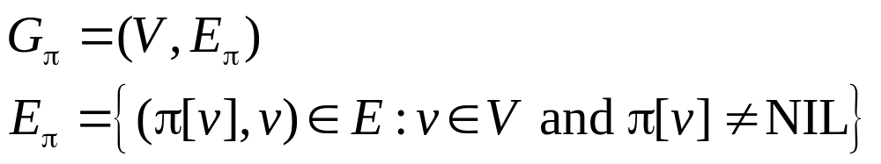
Predecessor Subgraph
Define slightly different from BFS
The PD subgraph of a depth-first search forms a depth-first forest composed of several depth-first trees
The edges in G_{π} are called tree edges

Slide 39
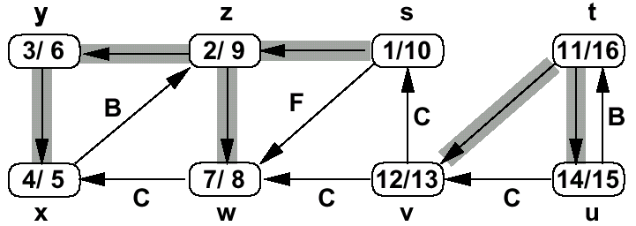
DFS Timestamping
The DFS algorithm maintains a monotonically increasing global clock
  discovery time d[u] and finishing time f[u]
For every vertex u, the inequality d[u] < f[u] must hold

Slide 40
DFS Timestamping
Vertex u is
  white before time d[u]
  gray between time d[u] and time f[u], and
  black thereafter
Notice the structure througout the algorithm.
  gray vertices form a linear chain
  correponds to a stack of vertices that have not been exhaustively explored (DFS-Visit started but not yet finished)

Slide 41
DFS Parenthesis Theorem
Discovery and finish times have parenthesis structure
  represent discovery of u with left parenthesis "(u"
  represent finishin of u with right parenthesis "u)"
  history of discoveries and finishings makes a well-formed expression (parenthesis are properly nested)
Intuition for proof: any two intervals are either disjoint or enclosed
  Overlaping intervals would mean finishing ancestor, before finishing descendant or starting descendant without starting ancestor

Slide 42
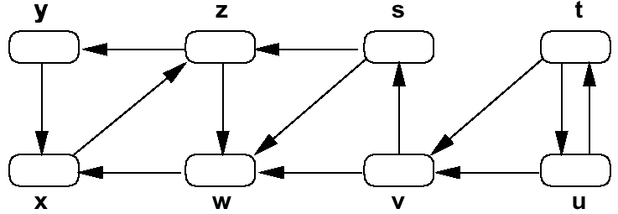
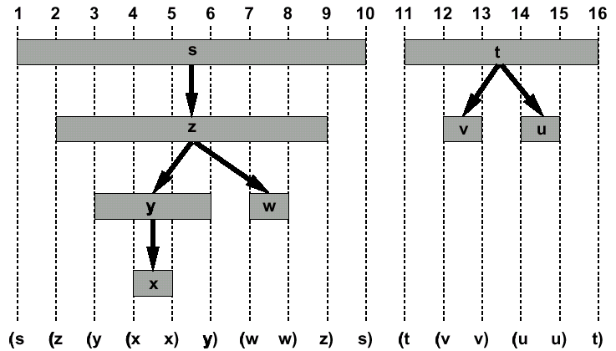
DFS Parenthesis Theorem (2)

Slide 43
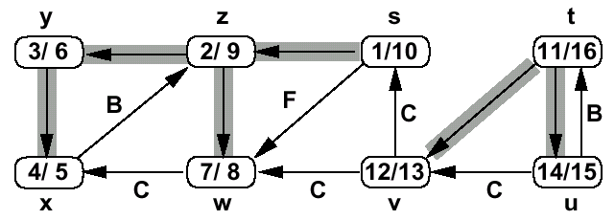
DFS Edge Classification
Tree edge (gray to white)
  encounter new vertices (white)
Back edge (gray to gray)
  from descendant to ancestor

Slide 44
DFS Edge Classification (2)
Forward edge (gray to black)
  from ancestor to descendant
Cross edge (gray to black)
  remainder – between trees or subtrees

Slide 45
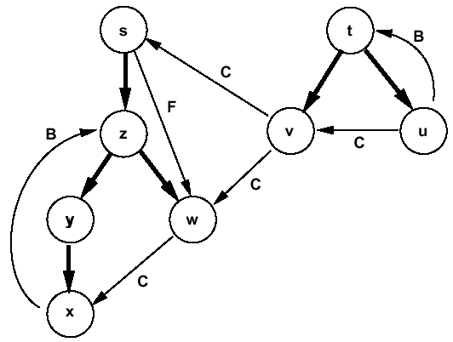
DFS Edge Classification (3)
Tree and back edges are important
Most algorithms do not distinguish between forward and cross edges

Slide 46
Next Lecture
Graphs:
  Application of DFS: Topological Sort
  Minimum Spanning Trees
  Greedy algorithms

